Slide 1
6-SQL_for_Analysts

Slide 2
Day 1: Intro to SQL

Slide 3
What is SQL?
SQL = Structured query language
SQL is a programming language used for storing and processing information in a relational database

Slide 4
What is a relational database?
A relational database contains at least two tables.
The tables have rows and columns, like a table in excel.
Each table has 1 or more primary keys, which are columns of values that can be used to identify specific rows in the dataset.
The tables are related to each other, and can be joined based on the primary keys.

Slide 5
Relational Database Example
Imagine a store has two tables: Sales and Products.
Sales contains the information about sales, including time, date, payment method, and product_id
Products contains information about the products, including price, weight, description, and product_id
Sales and Products tables can be joined on the product_id key.

Slide 6
Why Use A Relational Database?
Imagine the example of the store with sales and products.
Imagine they only had one table, where they kept track of sales and information about the product sold.
What would be the problem with this?

Slide 7
Why Use A Relational Database?
This means that for every single sale made, they have to add a row to the table not only of the sale information, but also including all the product details, since they do not have any other table with the product details saved.
Imagine the store has a total of 10 products, but makes 1000s of sales daily.
This would be repetitive and would also waste a lot of storage space.

Slide 8
Let's practice as we learn
We are going to practice queries online.
First, go to this website: https://www.db-fiddle.com/

Slide 9
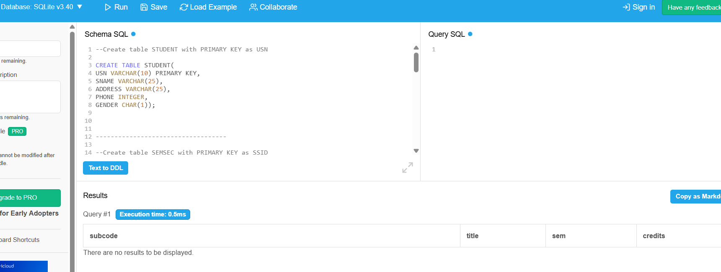
Let's practice as we learn
Let's add the schema in order to run queries.
Go to these two links and copy and paste the code into the left side of the db-fiddle page. Do not run it yet. https://github.com/teamkaliyona/vtu-dbms-lab/blob/main/DBMS-04-College%20Database/College-Create%20Table%20Scripts.sql
https://github.com/teamkaliyona/vtu-dbms-lab/blob/main/DBMS-04-College%20Database/College-Insert%20Scripts.sql

Slide 10
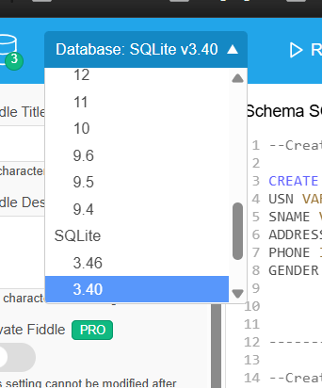
Let's practice as we learn
Set the database in the left corner to sqlite

Slide 11
Let's practice as we learn
Remove all lines that begin with DESC (ex: DESC STUDENT;)

Slide 12
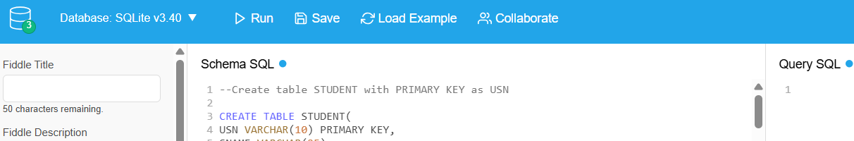
Let's practice as we learn
Now, click run. You will find it on the top left of the page

Slide 13
Let's practice as we learn
Important: Do not delete the code on the left side of db-fiddle.
The tables are not actually saved on the website, so if you delete the create table and insert statements, there will be no tables to query.

Slide 14
SELECT
SELECT & FROM are the building blocks of all SQL queries.
SELECT tells SQL which columns you want to view.
FROM tells SQL which table you want to work with.
Does anyone know what a basic SELECT + FROM statement looks like?

Slide 15
SELECT
Imagine we want to view the columns sname and address from the student table.
How would we do that?

Slide 16
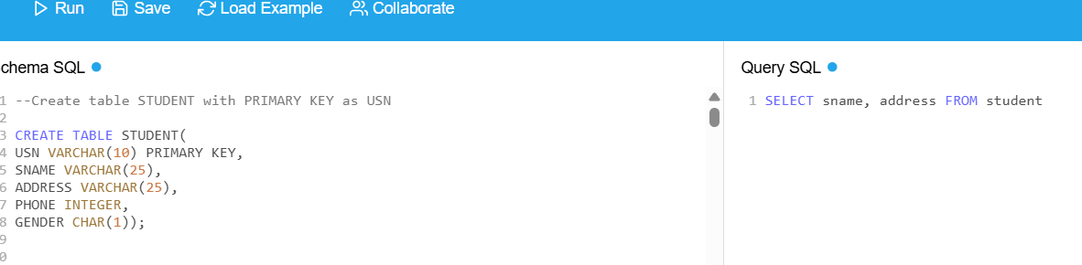
SELECT
View the columns sname and address from the student table:
SELECT sname, address FROM student
Type this statement into the right side of db-fiddle.
Click run in the top left of the page to run the statement and check your work.

Slide 17
SELECT
What if we want to view all the columns from the student table? How would we do that?

Slide 18
SELECT
What if we want to view all the columns from the student table? How would we do that?
SELECT * FROM student

Slide 19
SELECT
What if we want to view the column sname, but we want to call it first_name. How would we do that?

Slide 20
SELECT
What if we want to view the column sname, but we want to call it first_name. How would we do that?
SELECT sname as first_name FROM student

Slide 21
LIMIT
LIMIT is very important if you have a large dataset.
LIMIT sets the maximum number of rows that will be displayed from your query.
Always put LIMIT on the last line of the query

Slide 22
LIMIT
Example - display 2 rows from the student table:
SELECT *
FROM student
LIMIT 2

Slide 23
WHERE
After SELECT and FROM, WHERE is one of the most common SQL commands.
What is the purpose of WHERE?

Slide 24
WHERE
WHERE is a filter.
Imagine you want to view all columns from the subject table, but only view the rows which have 3 credits. How would you do that?

Slide 25
WHERE
SELECT *
FROM subject
WHERE credits =3

Slide 26
WHERE
Now imagine you want to view the title and sem (rename the column as semester) from the subject table, but only view the rows which have semester of 4 or more.
How would you do that?

Slide 27
WHERE
SELECT title, sem AS semester
FROM subject
WHERE sem >= 4

Slide 28
ORDER BY
ORDER BY tells SQL the order you want to use to view rows.
ORDER BY can take a column, or a list of columns.

Slide 29
ORDER BY
Imagine you want to see the student table, with the names ordered alphabetically.
How would you do that?

Slide 30
ORDER BY
Imagine you want to see the student table, with the names ordered alphabetically. How would you do that?
SELECT *
FROM student
ORDER BY sname

Slide 31
ORDER BY
Now, you want to see the names alphabetically, but from z to a.
What do you need to add to the query?

Slide 32
ORDER BY
Now, you want to see the names alphabetically, but from z to a.
What do you need to add to the query? DESC
SELECT *
FROM student
ORDER BY sname DESC

Slide 33
ORDER BY
Now, you want to see the iamarks table ordered by both test1 and test2, with test1 the priority order.
How would you do that?

Slide 34
ORDER BY
Now, you want to see the iamarks table ordered by both test1 and test2, with test1 the priority order.
How would you do that?
SELECT *
FROM iamarks
ORDER BY test1, test2

Slide 35
ORDER BY
Order by can take the column name, or it can take the number in the order in the select statement.
So, these two statements are the same:
Select sname, address from student order by sname
Select sname, address from student order by 1
If you wanted to order by address using the number notation, what would the statement be?

Slide 36
ORDER BY
If you wanted to order by address using the number notation, what would the statement be?
Select sname, address from student order by 2

Slide 37
COUNT, MIN, MAX, AVG
These commands are placed within the select statement, in order to count values, or to find the minimum, maximum, or average value.
How would we find the count of total rows in the student table?

Slide 38
COUNT, MIN, MAX, AVG
How would we find the count of total rows in the student table?
SELECT COUNT(*) AS total_rows
FROM student.

Slide 39
COUNT, MIN, MAX, AVG
How would we find the count of unique addresses in the student table?

Slide 40
COUNT, MIN, MAX, AVG
How would we find the count of unique addresses in the student table? Using DISTINCT
SELECT COUNT (DISTINCT address)
FROM student

Slide 41
COUNT, MIN, MAX, AVG
How would we find the maximum semester in the subject table?
SELECT MAX(sem) AS top_semester
FROM subject

Slide 42
COUNT, MIN, MAX, AVG
What about the minimum or average semester?

Slide 43
COUNT, MIN, MAX, AVG
What about the minimum or average semester?
SELECT MIN(sem) AS top_semester
FROM subject
SELECT AVG(sem) AS top_semester
FROM subject

Slide 44
Class 1 Review
Choose relevant topics from this list of quizzes:
https://www.w3schools.com/sql/sql_exercises.asp

Slide 45
Practice
https://sqlbolt.com/lesson/filtering_sorting_query_results
https://sqlzoo.net/

Slide 46
Day 1 Homework
Complete 3 SQL SELECT exercises from Mode tutorial

Slide 47
Day 2
GROUP BY, aggregations, and calculations

Slide 48
Day 2
e. RESOURCES:
i. SQL Aggregation Functions Reference
ii. Practice SQL Aggregation Queries

Slide 49
Review Homework
Share and run some of our queries.

Slide 50
GROUP BY
GROUP BY groups one or more sets of data and calculates the aggregate based on the group or groups defined in the GROUP BY statement.
This will make more sense with an example.

Slide 51
GROUP BY
Imagine you want to view the total count of students names for each address. How would you do it?

Slide 52
GROUP BY
Imagine you want to view the total count of students names for each address. How would you do it?
SELECT address, COUNT(sname) from student
GROUP BY address

Slide 53
GROUP BY
With GROUP BY, you can find the count, max, min, and other aggregations.
Make sure you aggregate all the data which is not being used by the group by. If not, you will usually get an error. (but in db-fiddle, it does not cause an error).
How would you fix the query below?
SELECT gender, COUNT(DISTINCT sname), address
FROM student
GROUP BY gender

Slide 54
GROUP BY
How would you fix the query below?
Remove ,address
SELECT gender, COUNT(DISTINCT sname)
FROM student
GROUP BY gender

Slide 55
GROUP BY
You can group by more than one value, and can show aggregations of more than one value too.
Example:
SELECT MAX(phone), MIN(phone), SUM(phone), COUNT(DISTINCT sname), address, gender
FROM student
GROUP BY address, gender

Slide 56
Aggregations
What are the aggregations you can do after a group by?

Slide 57
Aggregations
What are the aggregations you can do after a group by?
Count, sum, avg, min, max, count distinct
Note: You can also run these aggregations on a single column, like this:
SELECT MAX(date)
FROM sales_data_table

Slide 58
Sales and Customers Datasets
Take a few minutes and explore them using SQL and find some insights.
Share what you found with your classmates.

Slide 59
Homework
Write 2 GROUP BY queries on mock dataset

Slide 60
Class 3
b. Theory (Short summary)
i. JOINs: INNER, LEFT, RIGHT
c. Main things (Objectives)
i. Combine tables using SQL joins
ii. Write JOIN queries across 2–3 tables
d. For next day (Homework)
i. Join tables in a mock eCommerce database
e. RESOURCES:
i. SQL JOIN Cheatsheet
ii. JOIN Practice Exercises

Slide 61
Class 3
JOINS

Slide 62
Review Homework
Review the queries we made for homework.

Slide 63
Joins
What type of joins exist in SQL?

Slide 64
Joins
What type of joins exist in SQL?
Inner, left, outer, and right
Note: right joins are almost never used

Slide 65
The purpose of joins
What is the purpose of joins?

Slide 66
The purpose of joins
What is the purpose of joins?
Join two or more tables in order to discover insights about the data

Slide 67
Joins
Think about joining two tables. What do you need in order to join tables?
Think about this example:
If you have a table of customer names, ids, and addresses, could you join it with a table of recipe titles, main ingredients, and cooking times?

Slide 68
Joins
If you want to join two tables, what do they both need?

Slide 69
Joins
In order to join tables, there must be a column with shared values in both tables.
A column with an identifying value is called a primary key. A primary key could be, for example, a unique id.
A foreign key is a primary key placed in another table, for example, product_id is the primary key in the product table, and the foreign key in the sales table.
Often, tables are joined on primary and foreign keys, although they can be joined on other columns too.

Slide 70
Inner Join
What is an inner join?

Slide 71
Inner Join
What is an inner join?
Join only the values that are in both tables.

Slide 72
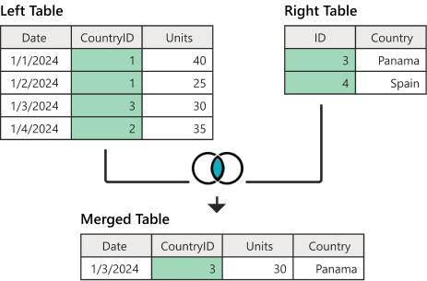
Inner Join
Which countryIDs (ID in the right table) will be in the inner join merged table?

Slide 73
Inner Join
If you join two tables using an inner join, the resulting table will have only rows in which the join key value is in both tables.

Slide 74
Left Join
What is a left join?

Slide 75
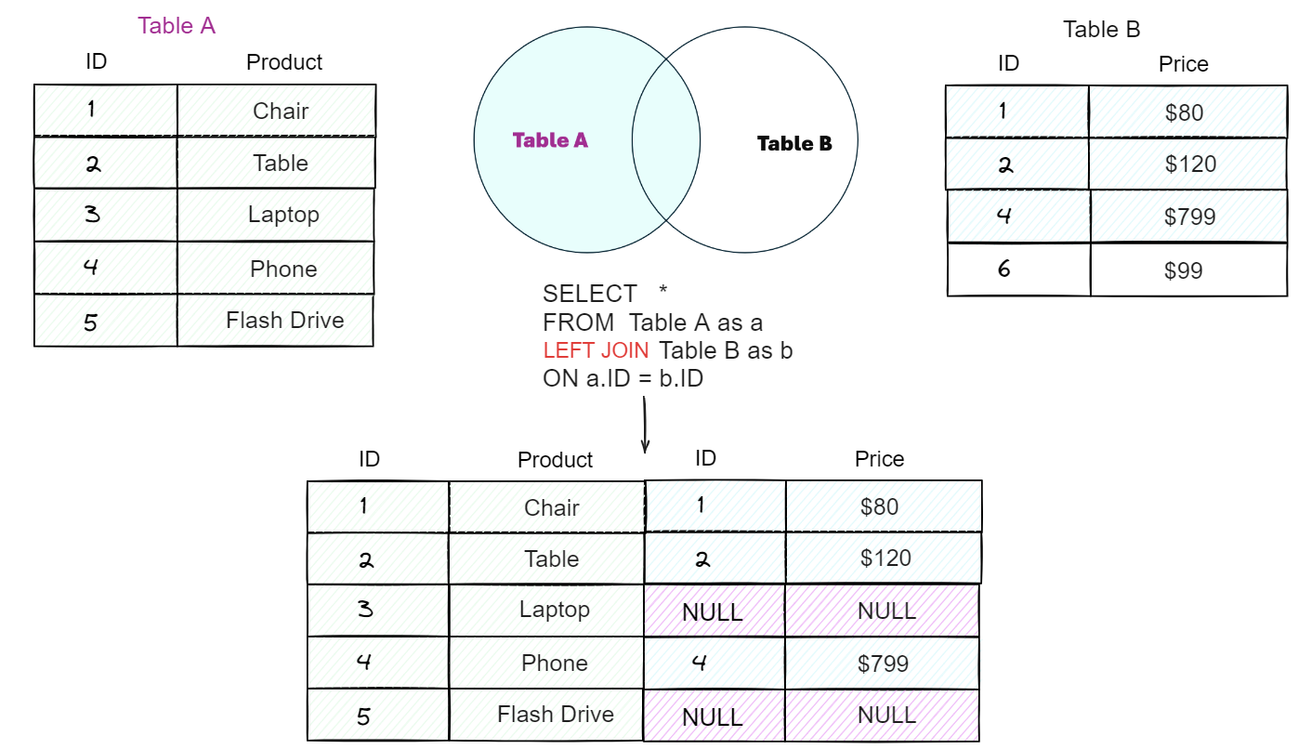
Left Join
Which IDs will be in the resulting table after the left join?

Slide 76
Left Join
All values on the table written first (the left) are preserved.

Slide 77
Outer Join
What is an outer join?

Slide 78
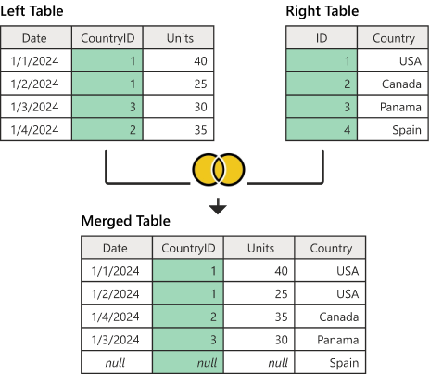
Outer Join
What will the merged table look like?

Slide 79
Outer Join
In an outer join, all rows are preserved.

Slide 80
Right Join
What is a right join?

Slide 81
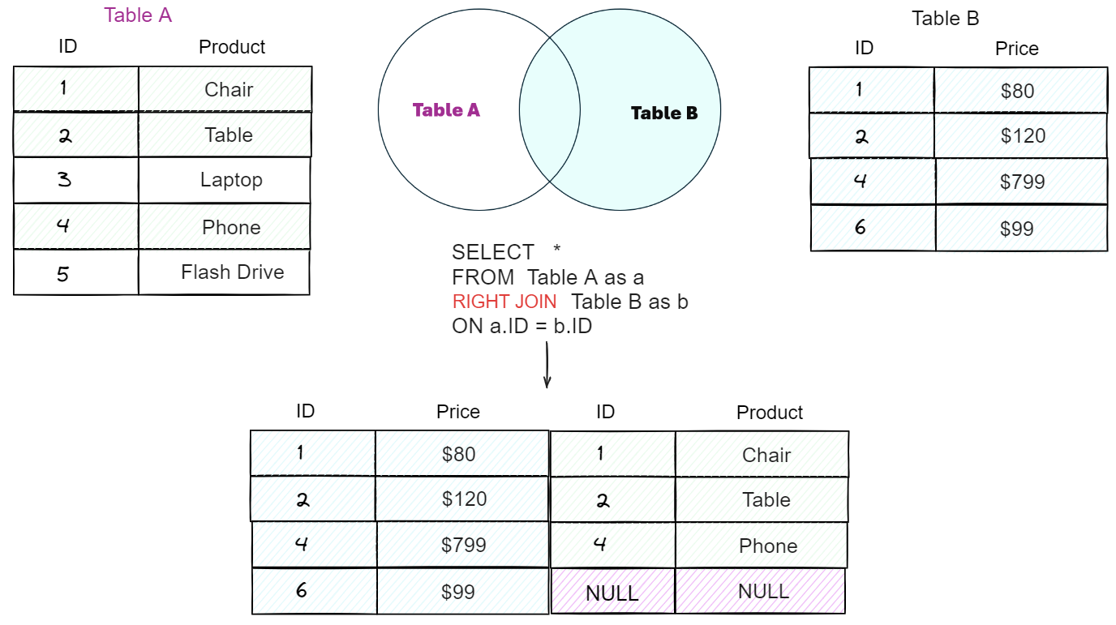
Right Join
All values on the second table in the join statement (the table written on the right) are preserved.

Slide 82
Right Join
Right joins are almost never used by programmers. They prefer left joins.
A right join and a left join can do the same thing - all you have to do is switch the order you write the tables in to change a right join to a left join.

Slide 83
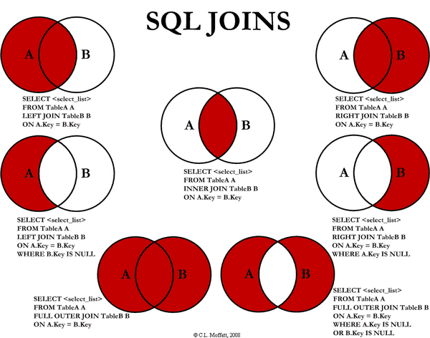

Slide 84
Joins Resources
For more information about joins, read this article, which discusses other more complex types of joins and how to do them in SQL
https://www.thedataschool.co.uk/le-luu/sql-joins/

Slide 85
Joins questions
Let's use this website to practice joins
https://www.codechef.com/learn/course/sql-intermediate/SQ00BS01/problems/ASQL01D
The website has exercises, but first let's do some queries together. (The website will say the answer is wrong, but that is okay, we can still see the results)

Slide 86
Joins Queries
We want to see the ids and names of only the customers who made orders.
How would we write the query?

Slide 87
Joins Queries
We want to see the ids and names of only the customers who made orders. How would we write the query?
SELECT customers.customer_id, customer_name
FROM customers
INNER JOIN orders
ON orders.customer_id=customers.customer_id
Notice we have to write the table name before the column name if the column name appears in both tables

Slide 88
Join Queries
SELECT cust.customer_id, customer_name
FROM customers cust
INNER JOIN orders o
ON o.customer_id=cust.customer_id
We can also substitute the table name with a letter or abbreviation.

Slide 89
Join Queries
How would you write the query to find all product_names, and the total quantity of each product ordered?

Slide 90
Join Queries
Find all product_names, and the total quantity of each product ordered:
SELECT products.product_name,
SUM(orders.quantity) AS total_orders
FROM products
LEFT JOIN orders
ON orders.product_name=products.product_name
GROUP BY 1
Notice it says GROUP BY 1.
You could also say GROUP BY products.product_name.

Slide 91
Joins Queries
We want to see all products, and all orders.

Slide 92
Joins Queries
We want to see all products, and all orders.
Select * from products
Full outer join orders
on orders.product_name=products.product_name

Slide 93
Joins Queries
Now, let's practice doing the exercises on the website.

Slide 94
Homework: Joins
Create a business scenario where your boss asks you a question related to data, and you need to use joins to answer it.
Create two scenarios, and create the answers for them.
You can use the free online dataset we looked at in class.

Slide 95
Class 4

Slide 96
Review Homework
Review Joins Homework

Slide 97
Subqueries
What is a subquery?

Slide 98
Subqueries
A subquery is a helper query written within a main query

Slide 99
Subqueries
Let's use the data on this website again: https://www.codechef.com/learn/course/sql-intermediate/SQ00BS01/problems/ASQL01D
What is the query below finding?
SELECT *
FROM products
WHERE price = (SELECT MAX(price) FROM products)

Slide 100
Subqueries
What is the query below finding?
SELECT *
FROM products
WHERE price = (SELECT MAX(price) FROM products)
-> All product information about the highest priced products

Slide 101
Subqueries
What is the query below finding?
SELECT product_name
FROM products
WHERE product_name IN (SELECT product_name FROM orders WHERE quantity = 1)

Slide 102
Subqueries
What is the query below finding?
SELECT product_name
FROM products
WHERE product_name IN (SELECT product_name FROM orders WHERE quantity = 1)
-> It is finding the names of the products which had an order quantity of 1.

Slide 103
Subqueries
Now try one yourself - Can you find the price of the item ordered most recently?

Slide 104
Subqueries
Now try one yourself - Can you find the price of the item ordered most recently?
SELECT price
FROM products
WHERE product_name IN (SELECT product_name FROM orders WHERE order_date = (SELECT MAX(order_date) FROM orders))

Slide 105
Subqueries, Nested Queries
The subquery we looked at on the last slide is an example of a nested query:
SELECT price
FROM products
WHERE product_name IN (SELECT product_name
FROM orders
WHERE order_date =
(SELECT MAX(order_date) FROM orders)
)

Slide 106
Common Table Expression (CTE)
Link multiple table logics together in order to get what you want

Slide 107
Common Table Expression (CTE): Example
WITH customer_orders AS (
SELECT
customer_id,
SUM(quantity) AS total_quantity
FROM orders
GROUP BY customer_id
)
SELECT
c.customer_id,
c.customer_name,
customer_orders.total_quantity
FROM customers c
JOIN customer_orders
ON c.customer_id = customer_orders.customer_id
ORDER BY total_quantity DESC;

Slide 108
CTE
Write a SQL query using a CTE to find the total amount spent by each customer on Electronics products only.
Display:
customer_id , customer_name, total_spent
Order the results from highest to lowest total spent.

Slide 109
CTE Solution
WITH electronics_spending AS (
SELECT
o.customer_id,
SUM(o.quantity * p.price) AS total_spent
FROM orders o
JOIN products p
ON o.product_name = p.product_name
JOIN categories c
ON p.category_id = c.category_id
WHERE c.category_name = 'Electronics'
GROUP BY o.customer_id
)
SELECT
cu.customer_id,
cu.customer_name,
electronics_spending.total_spent
FROM customers cu
JOIN electronics_spending
ON cu.customer_id = electronics_spending.customer_id
ORDER BY total_spent DESC;

Slide 110
CTE
You can stack many tables, like this:
WITH table1 AS (
SELECT
…..
),
table2 AS (
SELECT
…..
),
table3 AS (
SELECT
…..
)
SELECT * FROM table3

Slide 111
Conditional logic in SQL: CASE WHEN
CASE
WHEN condition1 THEN result1
WHEN condition2 THEN result2
WHEN conditionN THEN resultN
ELSE result
END;

Slide 112
CASE WHEN: Example
SELECT first_name, department_id, salary,
CASE department_id
WHEN 50 THEN 1.5 * salary
WHEN 12 THEN 2.0 * salary
ELSE salary
END AS "REVISED SALARY"
FROM Employee;

Slide 113
CASE WHEN Exercise
Write a SQL query that shows customer_name, total_spent, and a spending category based on total spent, according to the table in the next slide

Slide 114
CASE WHEN exercise
| Condition | Category |
| ------------------ | ------------ |
| total_spent ≥ 2000 | 'VIP' |
| total_spent ≥ 1000 | 'Regular' |
| total_spent < 1000 | 'Occasional' |
| No orders | 'No Orders' |

Slide 115
CASE WHEN Solution
SELECT
c.customer_name,
SUM(o.quantity * p.price) AS total_spent,
CASE
WHEN SUM(o.quantity * p.price) >= 2000 THEN 'VIP'
WHEN SUM(o.quantity * p.price) >= 1000 THEN 'Regular'
WHEN SUM(o.quantity * p.price) > 0 THEN 'Occasional'
ELSE 'No Orders'
END AS spending_category
FROM customers c
LEFT JOIN orders o
ON c.customer_id = o.customer_id
LEFT JOIN products p
ON o.product_name = p.product_name
GROUP BY c.customer_name;

Slide 116
COALESCE
The COALESCE Function in SQL
The COALESCE function returns the first non-null argument. It is particularly useful for handling NULL values and substituting them with a default value.
Syntax
COALESCE(value1, value2, ..., valueN)

Slide 117
COALESCE
Example Query:
SELECT COALESCE(last_name, '- NA -')
FROM Employee;
What will this return if last_name is Null?

Slide 118
COALESCE
Example Query:
SELECT COALESCE(last_name, '- NA -')
FROM Employee;
What will this return if last_name is Null?
It will return - NA -

Slide 119
COALESCE exercise
Go back to the CASE WHEN exercise and rewrite it using coalesce

Slide 120
CASE WHEN with COALESCE Solution
SELECT
c.customer_name,
COALESCE(SUM(o.quantity * p.price), 0) AS total_spent,
CASE
WHEN COALESCE(SUM(o.quantity * p.price), 0) >= 2000 THEN 'VIP'
WHEN COALESCE(SUM(o.quantity * p.price), 0) >= 1000 THEN 'Regular'
WHEN COALESCE(SUM(o.quantity * p.price), 0) > 0 THEN 'Occasional'
ELSE 'No Orders'
END AS spending_category
FROM customers c
LEFT JOIN orders o
ON c.customer_id = o.customer_id
LEFT JOIN products p
ON o.product_name = p.product_name
GROUP BY c.customer_name
ORDER BY total_spent DESC;

Slide 121
Calculated fields
You can create a new column based on an operation done on existing columns
For example:
SELECT field1+field2 AS fields_sum FROM table…

Slide 122
Homework
Create 2 CASE WHEN queries and 1 subquery

Slide 123
Class 5

Slide 124
Window functions: ROW_NUMBER, RANK, OVER()
What is a window function?

Slide 125
Window functions: ROW_NUMBER, RANK, OVER()
An SQL Window Function performs calculations across a set of rows that are related to the current row without "collapsing" them.
Think of it as looking through a "window" at a specific group of rows while still keeping every individual row in your final list.

Slide 126
Window functions versus group by
Similar to GROUP BY, however:
GROUP BY: Fuses many rows into one single summary row. You lose the individual details.
Window Function: Keeps every row as it is. It just adds a new column next to them containing the calculation result

Slide 127
Window function syntax
The Core Syntax: OVER()
The OVER() clause is what tells SQL you are using a window function. It has three optional parts:
PARTITION BY: Splits your data into groups (like "windows" for each department or category).
ORDER BY: Sets the order of rows within those groups (essential for things like running totals or rankings).
Rows/Range (Frame): Defines exactly which rows around the current one to look at (e.g., "the 3 rows before this one").

Slide 128
Window function syntax
function_name(expression) OVER (
[PARTITION BY column]
[ORDER BY column]
[ROWS/RANGE frame_specification]
)

Slide 129
Types of Window functions
Common Types of Window Functions
Aggregate Functions: Use standard math like SUM(), AVG(), or COUNT() but across a window.
Example: Calculate a "running total" of sales as you go down the list.
Ranking Functions: Assign a number to each row based on its position.
Example: ROW_NUMBER() gives each row a unique number; RANK() can handle ties.
Value (Offset) Functions: Let you "peek" at other rows without using a join.
Example: LAG() looks at the row above (useful for comparing today's price to yesterday's); LEAD() looks at the row below

Slide 130
Window functions: ROW_NUMBER, RANK, OVER()
Useful resource: https://www.codecademy.com/resources/docs/sql/window-functions

Slide 131
Window functions practice
Go to: https://www.codechef.com/learn/course/sql-intermediate/SQ00BS01/problems/ASQL01D
Group the orders table by the order date. Show the product, the order date, and the total quantity of orders on that day.

Slide 132
Window functions practice
Group the orders table by the order date. Show the product, the order date, and the total quantity of orders on that day.
Select product_name, order_date,
sum(quantity) OVER (
PARTITION BY order_date
ORDER BY order_date
)
from orders

Slide 133
ROW_NUMBER
From the products table, group the products by category id, and put the categories in order based on average price. Add a row number.

Slide 134
ROW_NUMBER
From the products table, group the products by category id, and put the categories in order based on average price. Add a row number.
SELECT
category_id,
AVG(price) AS avg_price,
ROW_NUMBER() OVER (
ORDER BY AVG(price)
) as category_rank
FROM products
GROUP BY category_id;

Slide 135
ROW_NUMBER
From the orders table, group the products by product name, and put the categories in order based on average quantity. Add a row number.

Slide 136
ROW_NUMBER
From the orders table, group the products by product name, and put the categories in order based on average quantity. Add a row number.
SELECT
product_name,
AVG(quantity) AS avg_quantity,
ROW_NUMBER() OVER (
ORDER BY AVG(quantity)
) as quantity_rank
FROM orders
GROUP BY product_name;

Slide 137
ROW_NUMBER
From the orders table, group the products by product name, and put the categories in order based on average quantity. Add a row number.
Notice that the row number goes from 1 to 4, even though the avg quantity stays the same.
What if we wanted the row number to stay the same if the quantity is not increasing? (So if two products have 3 average orders, both would have the same row number)

Slide 138
RANK
What if we wanted the row number to stay the same if the quantity is not increasing? (So if two products have 3 average orders, both would have the same row number)
Change row_number to rank in the last query and see what happens

Slide 139
Use Multiple window functions
You can put multiple windows functions in the same query.
You want to display the min and max order date for each product from the orders table. How?

Slide 140
Use Multiple window functions
You want to display the min and max order date for each product from the orders table:
SELECT distinct
product_name,
max(order_date)
OVER (
partition by product_name
) as max_date,
min(order_date)
OVER (
partition by product_name
) as min_date
FROM orders

Slide 141
Use SQL to perform calculations across partitions
Add a column, price_diff, which is the max price minus the min price.

Slide 142
Use SQL to perform calculations across partitions
Add a column, price_diff, which is the max price minus the min price.
SELECT DISTINCT
category_id,
MAX(price) OVER w AS max_price,
MIN(price) OVER w AS min_price,
MAX(price) OVER w - MIN(price) OVER w AS price_diff
FROM products
WINDOW w AS (PARTITION BY category_id);

Slide 143
Homework
Practice 3 window function problems

Slide 144
Class 6
SQL mini-project

Slide 145
Review Homework
Window function solutions

Slide 146
In-class assignment
Mini-project: Write a SQL report for business KPIs using a mock database (PostgreSQL or SQLite) - You choose the data.
As we work, we will stop and share what we have created so far.

